Slide 1
AI Medical Chatbot using RAG (Dr. Ai)

Slide 2
Team Member:
Name | Unique Id
Shajar Abbas (Leader) | 18045
Usama | -
Burhan Shezad | -
Sammar Abbas | -

Slide 3
Problem Statement
Access to instant, trustworthy medical advice is limited, especially in underserved areas and outside clinical hours. People often rely on unreliable sources for health queries, leading to confusion or poor decisions.
Dr. AI is an AI-powered chatbot that provides accurate, conversational medical guidance using trusted sources. It helps users understand symptoms, medications, and general health concerns—bridging the gap between online search and professional care.

Slide 4
PROJECT LAYOUT
Phase 1–Setup Memory for LLM (Vector Database)
Load raw PDF(s)
Create Chunks
Create Vector Embeddings
Store embeddings in FAISS
Phase 2–Connect Memory with LLM
Setup LLM (Mistral with HuggingFace)
Connect LLM with FAISS
Create chain
Phase 3–Setup UI for the Chatbot
Chatbot with Streamlit
Load Vector store (FAISS) in cache
Retrieval Augmented Generation–RAG

Slide 5
Tools & Technologies
Langchain (AI Framework for LLM applications)
HuggingFace (ML/AI Hub)
Mistral (LLM Model)
FAISS (Vector Database)
Steamlit (For Chatbot UI)
Python (Programming Language)
VS Code (IDE)

Slide 6
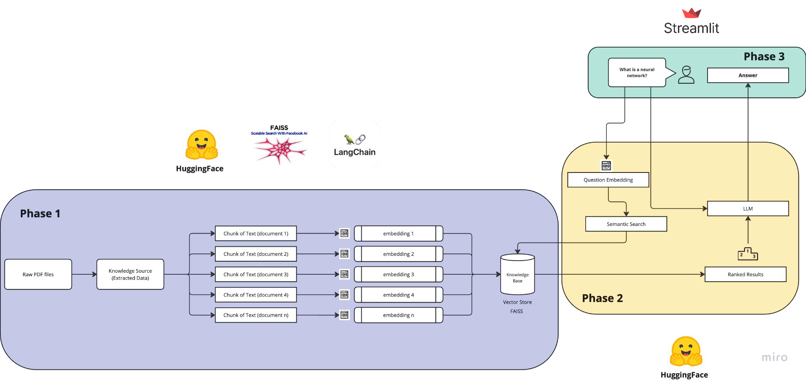
Technical Architecture

Slide 7
Improvement Potential/Next Steps
Add authentication in the UI
Make use of self-upload document functionality
Add multiple documents and embed them together
Add Unit testing of RAG applications

Slide 8
Summary
Modern AI Chatbot for Documents
Modular 3 phased Chatbot project
About Chatbot
Streamlit | Langchain | HuggingFace
RAG
Vector Embeddings
End to End RAG pipeline
Future Possibilities
Any sort of Feedback will be highly appreciated

